Slide 1

PROJECT
EFFICIENT DELIVERY: ROUTE PLANNER
Presented By:
Nitish Kumar(2K19/IT/093)
Naveen Kumar(2K19/IT/093)
Github Link: https://github.com/Nitish9711/Efficient-Delivery-Route-Planner

Slide 2
Introduction
Objective
Project Overview
Description
Modules
User Interface
Flow Charts
Advantages
References
PRESENTATION OUTLINE
TOPICS TO BE COVERED

Slide 3
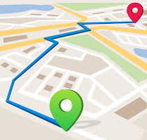
REASON FOR THIS PROJECT!
PROBLEM STATEMENT:
We are trying to implement a software for a logistics management company. We have linked our services to another corporation which gives us a set of parcels/orders to be delivered to different locations.
Out motto is to develop a way to efficiently manage the databases of our employees and assign them with orders to be delivered and to produce an output in the form of a Graph.
We expect the efficacy of our project to be 70%.

Slide 4
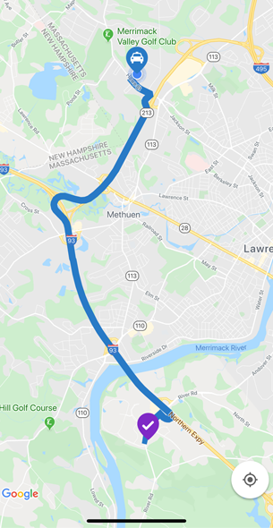
WHY WE?
Well,our route plan holds a lot of weight for your field service business – not only do they impact your employees, but they are critical to providing a positive customer experience.
It can be challenging to build the perfect route that meets all of your requirements while allowing you to run a profitable business.
But yes, with the right technology and processes in place, it can be done!
Our focus is to increase the efficiency and customer satisfaction level.

Slide 5
POINT TO PONDER!
PEOPLE DON'T BUY WHAT YOU DO; THEY BUY WHY YOU DO IT.
- SIMON SINEK, AUTHOR

Slide 6
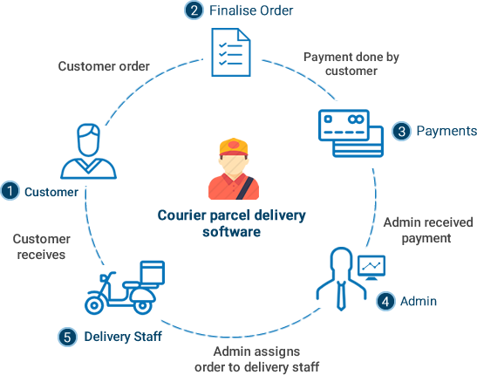
PROJECT OVERVIEW:
What We Are Working On(Description):
We would be having an employee database,and a database consisting of all the orders with their unique order Id.
Now we have already received the parcel from the user and our process starts now and our aim being,delivering the parcel by the earliest with keeping in mind the cost factor.We then process our orders(apply algorithm) and distribute them in such a manner that we are able to build an efficient system.Now we assign orders to our employees(delivery persons) and return the shortest path which each employee would follow while delivering the parcels using Graph Theory and output the path based upon the input given..
There would be a registration page and login page exclusively for the manager who will then be able to make changes to the employee database and the database of the orders..Manager would be able to see a graph which every delivery person would follow and to each delivery person the path followed by him/her would be shared via
e-mail.

Slide 7
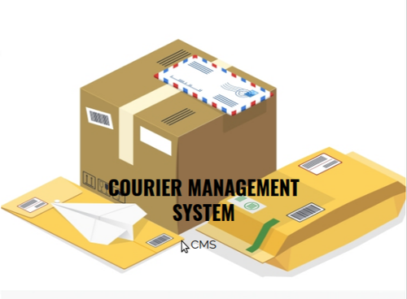
Operating on:
LANGUAGE USED:
Python
Packages Used:
NumPy
pandas
gmplot
pymongo
pymysql
tkinter
Data Base Managed:
MongoDB
MySQL
API Used:
mapmyindia
opencage data
Google OCR platform
OBJECT ORIENTED PROGRAMMING CONCEPTS USED:
Inheritance
Constructors
Destructors
Const and static variable and function concepts
Data encapsulation
Data abstraction
Operator overloading

Slide 8
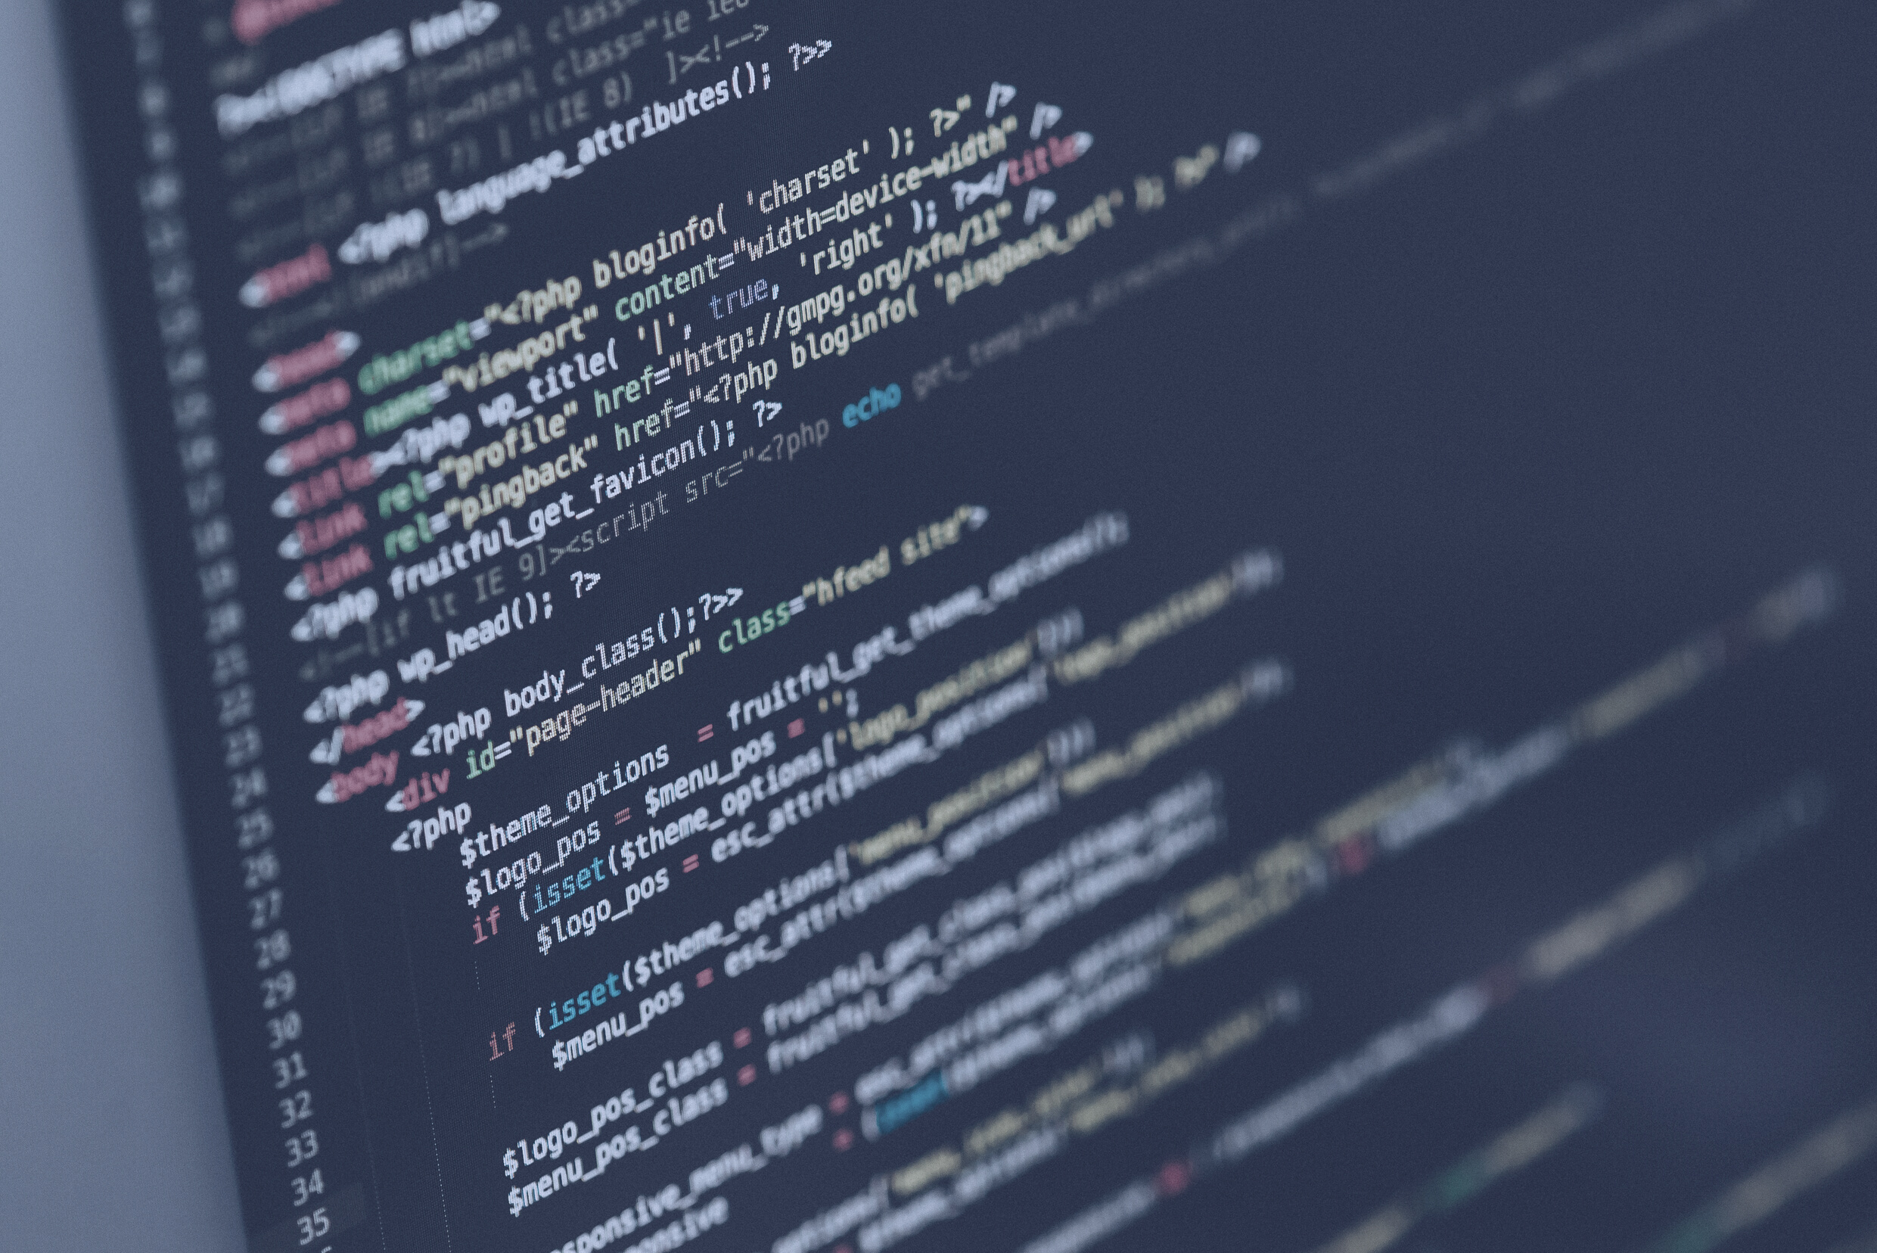
REGISTRATION WINDOW:
This pane would consist of multiple add-ons specifically built for company's manager who is solely responsible for managing the Software.
Interface:
LOGIN WINDOW:
The Login Window would enable the manager to access the databases of employees and placed orders and would be able to make changes to them..
FINAL OUTPUT:
In the final outcome we would like to present the plotting/path followed by every employee.The specific path which would be followed by every delivery person would be shared with them separately via their e-mail and a complete set of plots would be visible to the manager as well..We would like to accomplish this using python's inbuilt module TKinter!!

Slide 9
DISTINCTIVE FEATURES OF OUR PROJECT
EASE OF ACCESSIBILITY
SUSTAINABLE
As in our project we have tried covering everything under one roof so we would not have to maintain multiple copies here and there and everything would be easily accessible without putting in much effort.
The designing of our project is such which we expect to sustain for a larger span of time frame.
EFFICIENCY
USER FRIENDLY
Efficiency plays a vital role in any software and with that keeping in mind we have tried our best to give the best shot and have the most appropriate outcome..
As we have built the project from scratch so we tried to make it as simple and easy to use for the user,and it doesn't really require much effort to understand the software..

Slide 10
Flowchart
Update
First time Login
No
Yes
Login
New user
Yes
start
No
No
Yes
Upload Employee sheet
Register
Upload Employee sheet
Upload Order List
Output
Processing of data
Stop

Slide 11
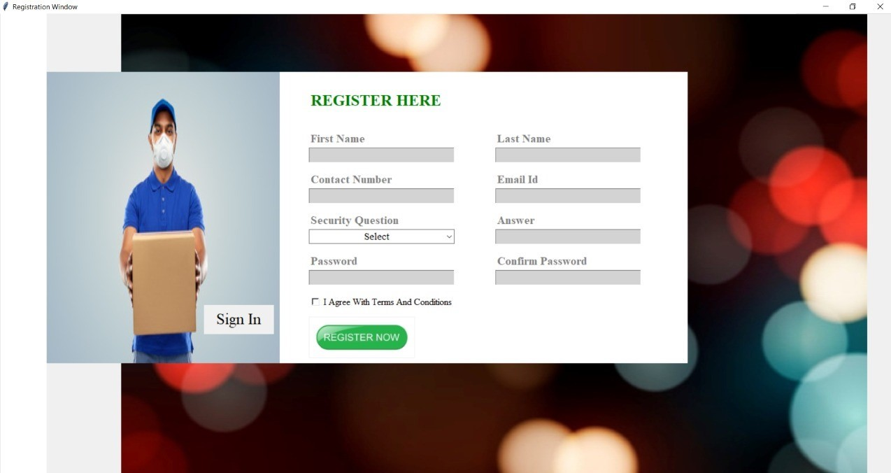
INTERFACE SCREENSHOTS CREATED TILL NOW

Slide 12
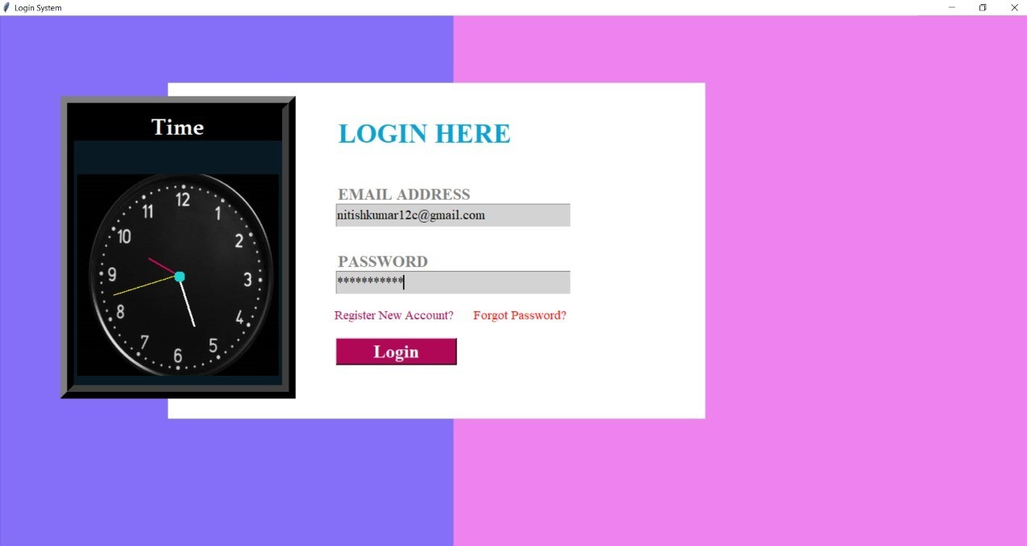
INTERFACE SCREENSHOTS CREATED TILL NOW

Slide 13
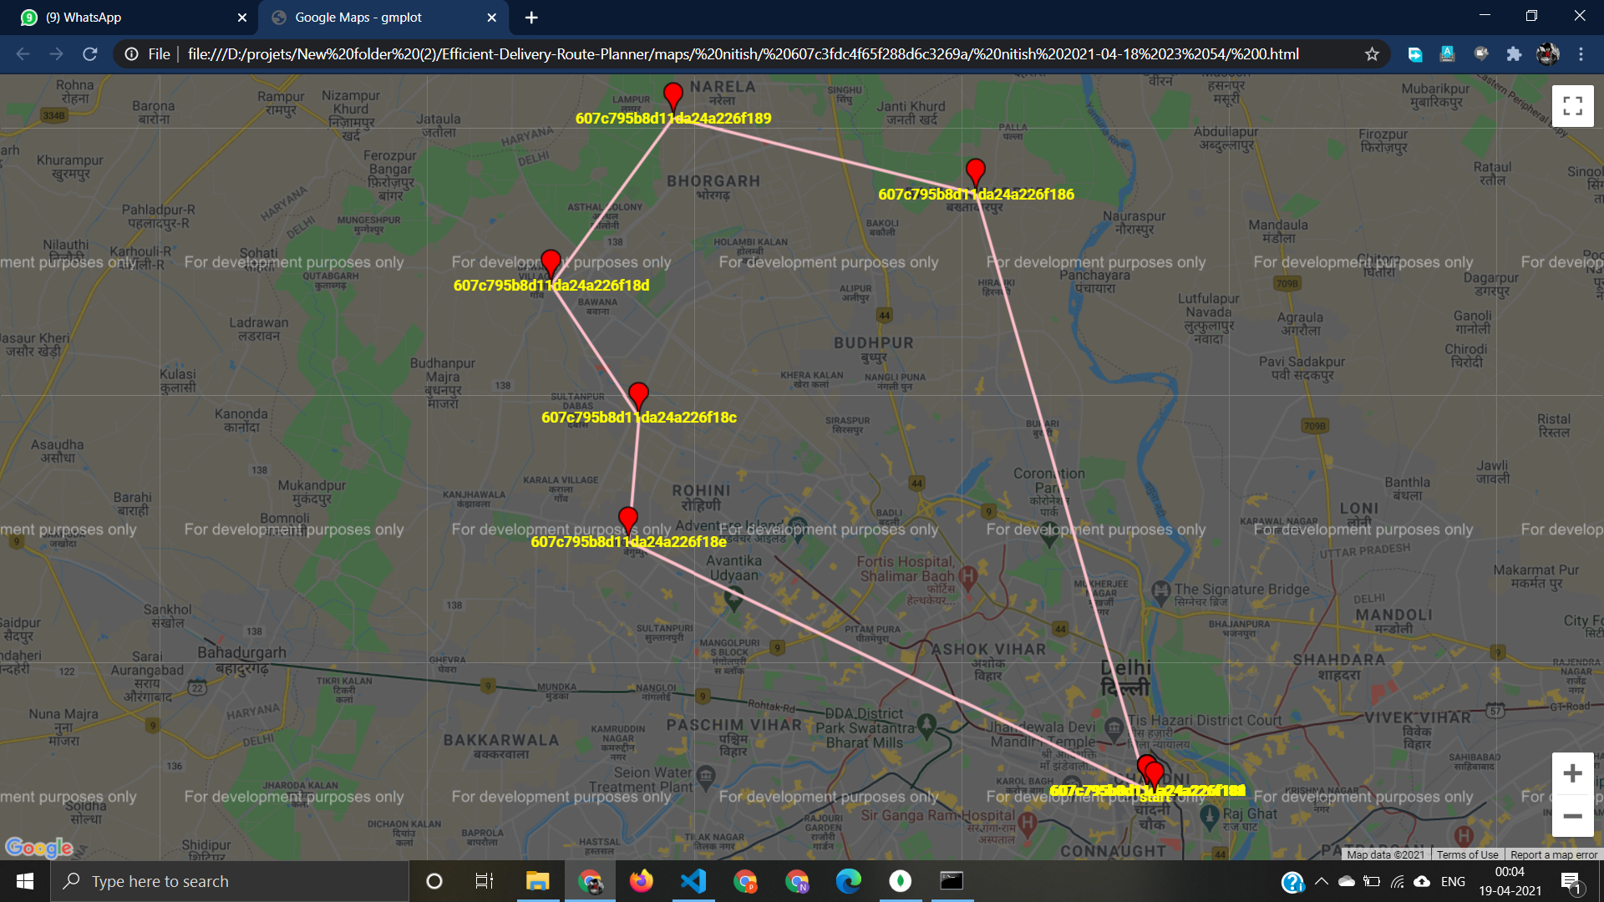
Plotted Map

Slide 14

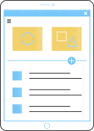


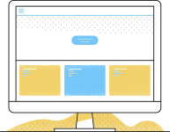
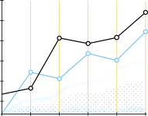






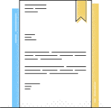
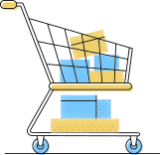
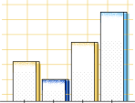





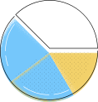
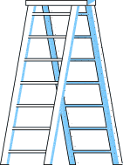




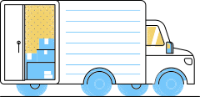

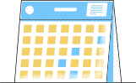
References:
https://www.codementor.io/blog/basic-pathfinding-explained-with-python-5pil8767c1
https://www.codementor.io/blog/basic-pathfinding-explained-with-python-5pil8767c1
https://www.geeksforgeeks.org/python-program-for-dijkstras-shortest-path-algorithm-greedy-algo-7/

